Slide 1
CODE QUALITY
HOW TO WRITE CLEAN CODE

Slide 2
agenda
What is code quality
Variables
Functions
Classes
COMMENTS
CONDITIONALS
Exceptions
REFACTORING

Slide 3

What is code quality
Everyone from us wants to be a better Programmer

Slide 4
HIGH QUALITY CODE SHOULD BE:
Easy to read
CLEAR INTENT
SIMPLE
Easy to understand and find potential codding errors and bugs.
Clear purpose, structure and meaningful names.
Too complex code is difficult to maintain and also leads to more bugs over time.
MINIMAL
THOUGHTFULL
TESTABLE
Each part of the code is minimal and do only one thing. Dependencies in the code are kept to a minimal.
Code is organized in the logical classes and clean methods. Classes are logically organized into layers.
Well written code is easier to test. Automated testing improves code quality.
Predictable
SELF-DOCUMENTED
EXTENSIBLE
Should handle unexpected inputs or user actions by anticipating them and responding accordingly.
Naming and layers of abstraction are so well chosen that no any additional documentation is needed.
Good code flexible and can be changed without huge impact to other system modules.

Slide 5
“WE Write code for humans, not machines”

Slide 6
What is code quality
“Clean code is simple and direct. Clean code reads like well-written prose.”
- Grady Booch, author of Object Oriented Analysis and Design with Applications
“Always code as if the guy who ends up maintaining your code will be a violent psychopath who knows where you live.”
- John Woods
“Any fool can write code that a computer can understand.”
- Martin Fowler, author of Refactoring: Improving the Design of Existing Code

Slide 7
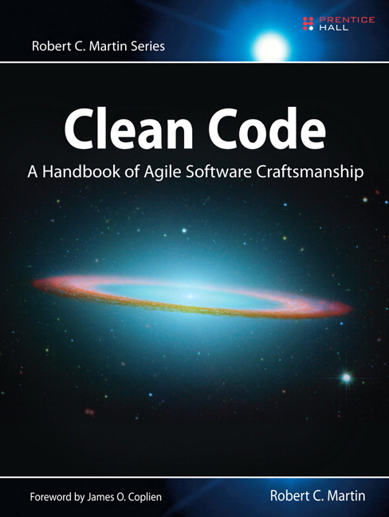
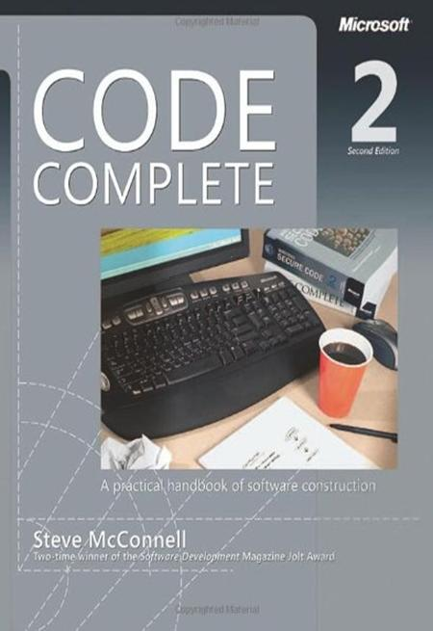
Resources
https://sourcemaking.com/

Slide 8

WARNING!
Please note that there are no strict rules about codding. These guidelines are only suggestions and may defer from your project requirement's specifications and personal preferences.

Slide 9
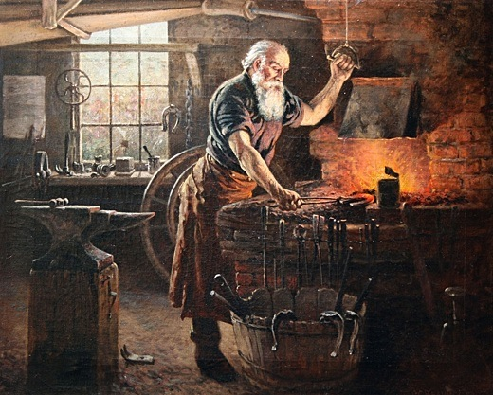
FORMATTING
TABS AND SPACES
VERTICAL Alignment
BRACES
Forge your code properly by:

Slide 10
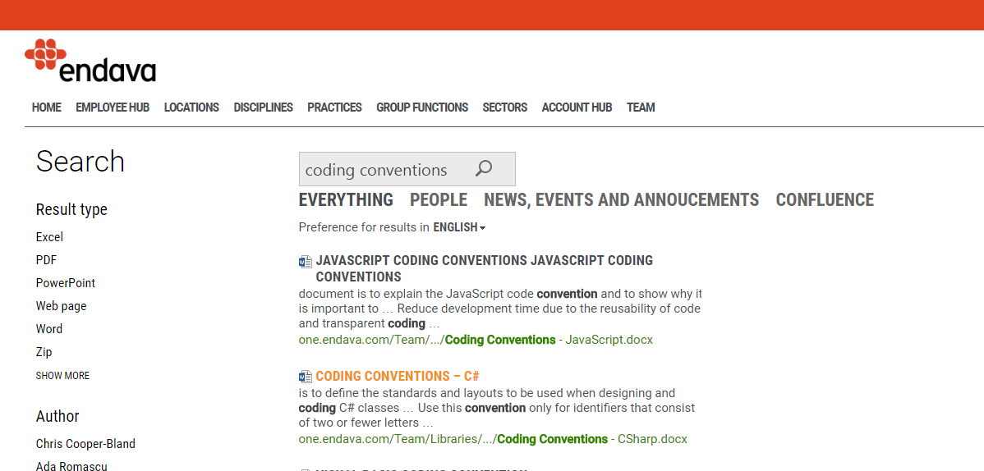
Coding Conventions
https://one.endava.com/
LINK FOR ONE.ENDAVA.COM

Slide 11
agenda
What is code quality
NAMING
Functions
Classes
Comments
CONDITIONALS
Exceptions
REFACTORING

Slide 12
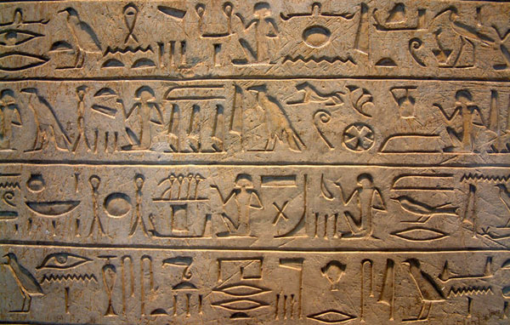
NAMING
WHY NAMES ARE SO IMPORTANT?
One difference between a smart programmer and a professional programmer is that the professional understands that clarity is king.

Slide 13
NAMING
USE INTENTION-Revealing NAMES
PREFIX AND UNDERSCORES
int x;
int counter;
string email_For_Contacts;
string emailForContacts;
DON’T USE NOISE WORDS
DON’T USE VERY ALIKE NAMES
CustomerObject;
Customer;
GraphicsControllerForStorageDevicesData
GraphicsControllerForHandlingDevicesData
Avoid Encodings
Pascal case for Acronyms
curentOpenTasksList
COTList
XMLDocument
XmlDocument

Slide 14
NAMING
CLASSES NAMES:
FUNCTIONS NAMES
Should be noun or noun phrase
Avoid words like Manager, Processor, Data or Info
Should be verb or verb phrase
If, Or, And are signs that function does more than one thing
Avoid side effects
BOOLEAN NAMES:
Boolean name starts with is or if
Think in a positive way

Slide 15

NAMING
USE SOLUTION DOMAIN NAMES
Pick one word for one abstract concept and stick with it. For instance, it’s confusing to have fetch, retrieve, load and get as equivalent methods.
Pick one word per concept
Use problem domain names
Be consistent in your names
Choose key words

Slide 16
agenda
What is code quality
NAMING
Functions
Classes
COMMENTS
CONDITIONALS
Exceptions
REFACTORING

Slide 17

FUNCTIONS
How short should a function be?
Function should be very small or even smaller.
20-30 lines
Each function tells its own short story.
Each function lead you to the next.
Each function should be transparently obvious.

Slide 18
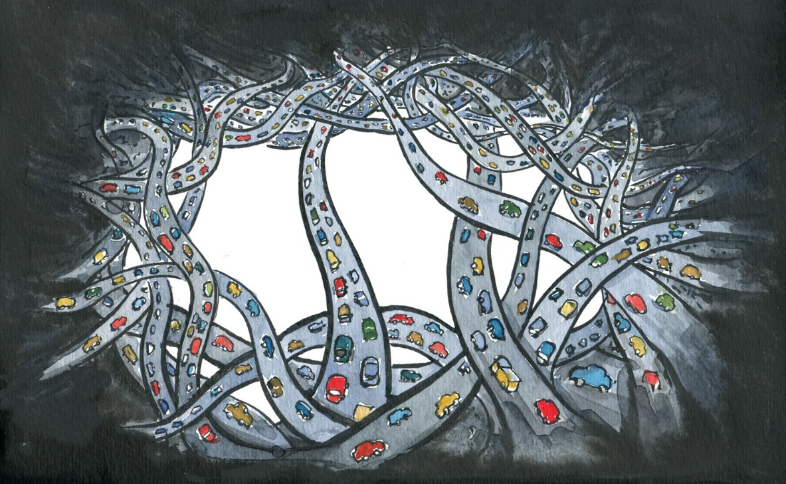
FUNCTIONS
Method should do one thing
and do one thing well

Slide 19
FUNCTIONS
WHAT MAKES FUNCTIONS DIRTY?
WHAT MAKES FUNCTIONS good?
FUNCTION IS LONG
ONE LEVEL OF ABSTRACTION
CONDITIONAL STATEMENTS
0-2 LEVEL OF INDENTIONS
MANY RESPONSIBILITIES
NO DUPLICATED CODE
text
LEVELS OF INDENTIONS
ONE OPERATION IN NESTED BLOCKS
TEXT
text

Slide 20

FUNCTIONS
ARGUMENTS
Arguments are hard. The argument is at a different level of abstraction than the function name and forces you to know a detail.
The ideal number of arguments is zero
The maximum length of arguments should be 3
Avoid output arguments
Avoid flag arguments
What is more clear? appendHtmlHeader(report)
report.appendHtmlHeader();

Slide 21

FUNCTIONS
VARIABLES LOCATION & INITIALIZATION

Slide 22
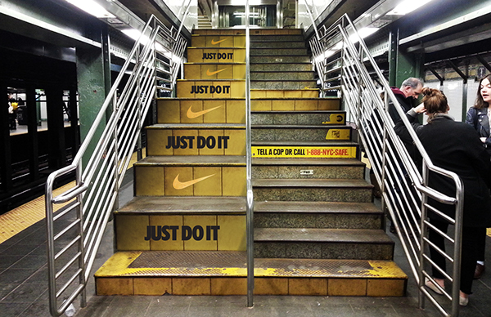
FUNCTIONS
Reading code from top to bottom
We want every function to be followed by those at the next level of abstraction so that we can read the program, descending one level of abstraction at a time as we read down the list of functions.
This is called The Stepdown Rule

Slide 23

FUNCTIONS
ONE RETURN vs RETURN EARLY
“Use a return when it enhance readability. Once you know the answer not returning immediately means that you have to write more code.”
– Steve McConnell, author of the book Code Complete
If you have nothing more to do, return.

Slide 24

FUNCTIONS
FIRST MAKE IT WORK, THEN REFACTOR IT
Once I write functions, they come out long and complicated. They have lots of indenting and nested loops. They have long argument lists. The names are arbitrary, and there is duplicated code.
So then I start to refactor it, splitting out functions, changing names, eliminating duplication. I shrink the methods and reorder them.
- Robert C. Martin

Slide 25
agenda
What is code quality
NAMING
Functions
Classes
COMMENTS
CONDITIONALS
Exceptions
REFACTORING

Slide 26

CLASSES
Class Organization
Public static constants
Private static constants
Private fields (public fields should not exist)
Class constructors
Public functions
Private functions using step-down rule

Slide 27

CLASSES
CLASS SHOULD BE SMALL!
The Single Responsibility Principle (SRP) states that a class or module should have one, and only one, reason to change. This principle gives us both a definition of responsibility, and a guidelines for class size.
Classes should have one responsibility — one reason to change.

Slide 28

CLASSES
TOO MANY SMALL CLASSES
However, a system with many small classes has no more moving parts than a system with a few large classes.
Summary: We want our systems to be composed of many small classes, not a few large ones.
Each small class encapsulates a single responsibility, has a single reason to change.

Slide 29
CLASSES
HIGH COHESION
LOW COUPLING
The more variables a method manipulates the more cohesive that method is to its class.
A class in which each variable is used by each method is maximally cohesive
Coupling is the degree of interdependence between software modules.
Decoupling:
Inversion of Control and DI
Layered architecture (MVC,MVP, etc.)
COHESION
HIGH
COUPLING
LOW
Low coupling and high cohesion is often a sign of a well-structured computer system and a good design

Slide 30
agenda
What is code quality
NAMING
Functions
Classes
COMMENTS
CONDITIONALS
Exceptions
REFACTORING

Slide 31

COMMENTS
DON’T COMMENT BAD CODE, REWRITE IT.

Slide 32
COMMENTS
CONS:
Examples:
Redundant comments
Explaining intent comments
Excessive information
Unnecessary information
Zombie code
Closing brace comments
OLD COMMENTS CAN LIE
HARD TO KEEP ACTUAL
USED TO EXPLAIN BAD CODE
MAKE CODE LONGER

Slide 33
COMMENTS
PROS:
Examples:
Explain complex logic
ToDo comments
Summary XML comment
Documentation
DESCRIBE INTENTIONS
GIVE ADDITIONAL INFO
WHEN DO YOU NEED COMMENTS?
CONTAIN UNNECESSARY INFO
Prefer expressive code over comments.
Use comments when code alone can’t be sufficient.

Slide 34
agenda
What is code quality
NAMING
Functions
Classes
COMMENTS
CONDITIONALS
Exceptions
REFACTORING

Slide 35

CONDITIONALS
IF statements
Don’t create many nested if/else statements
Main logic goes in if block no in else block
Encapsulate complex condition with a function
text

Slide 36
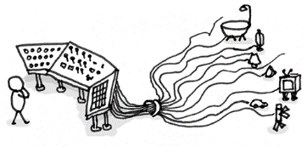
CONDITIONALS
SWITCH statements
problems
Solutions
Can’t be small
Always does more than one thing
Violate Open Closed Principle (SOLID)
POLYMORFISM
ABSTRACT FACTORY
INHERITANCE
text

Slide 37
agenda
What is code quality
NAMING
Functions
Classes
COMMENTS
CONDITIONALS
Exceptions
REFACTORING

Slide 38

EXCEPTIONS
NEVER USE Exceptions to Control Application Flow

Slide 39
EXCEPTIONS
DEFINE THE NORMAL FLOW
DON’T RETURN ERROR CODES
Your code should have a good amount of separation between your business logic and your error handling.
Its better to throw an exception because error codes requires additional if statements for checking them and lead to deeply nested structures.
Provide Context WITH EXCEPTION
DON’T EAT AN ERROR
Always log an additional information when catching and exception. It can help you to investigate the root cause of the problem.
If you caught an exception – do something, don’t eat an exception.

Slide 40
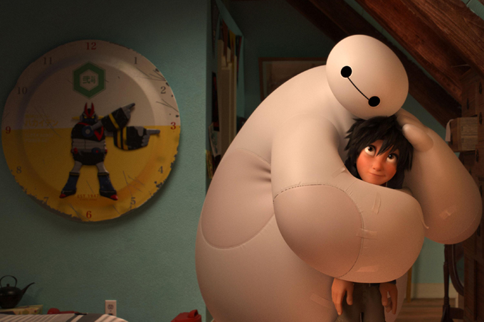
EXCEPTIONS
WAYS TO HANDLE AN EXCEPTION
Log an ERROR
React to an ERROR:
Rethrow an exception
Return null
Return default value
Ignore

Slide 41
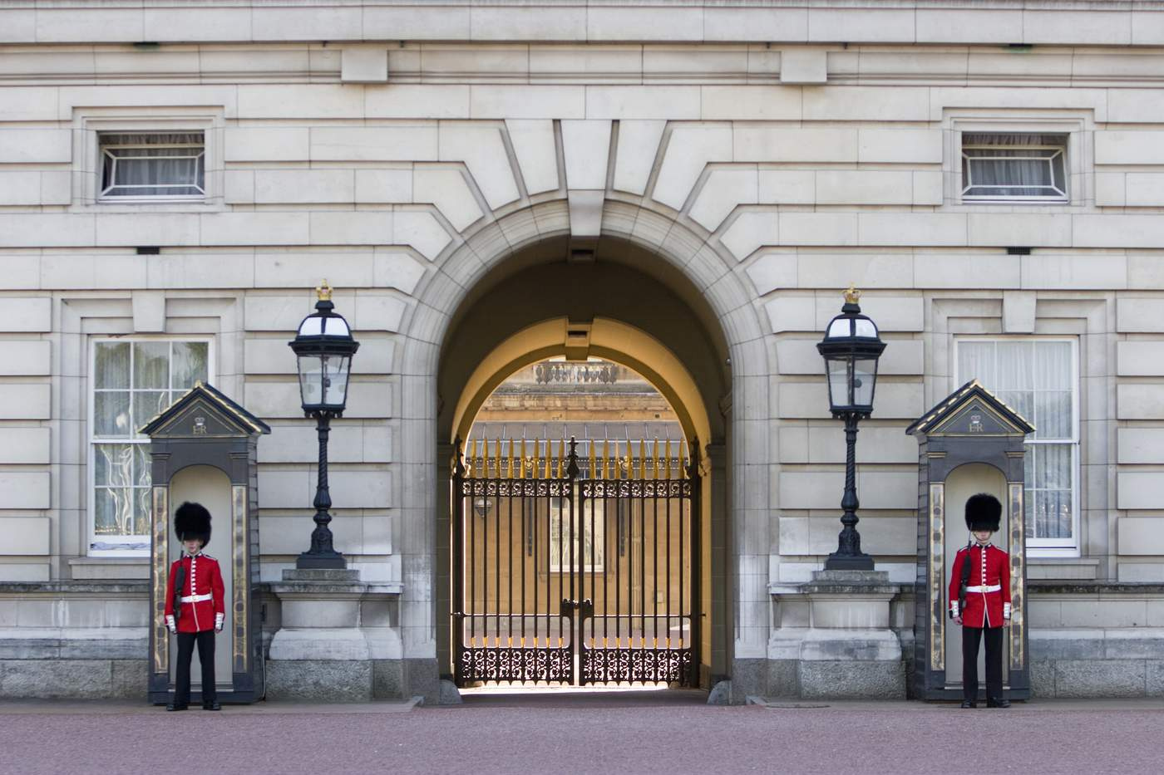
EXCEPTIONS
FAIL FAST
When there is nothing more that you can do in a method just fail.
This technique helps on reducing unnecessary indentation and keeping our functions small.

Slide 42
agenda
What is code quality
Variables
Functions
Classes
Comments
CONDITIONALS
Exceptions
REFACTORING

Slide 43
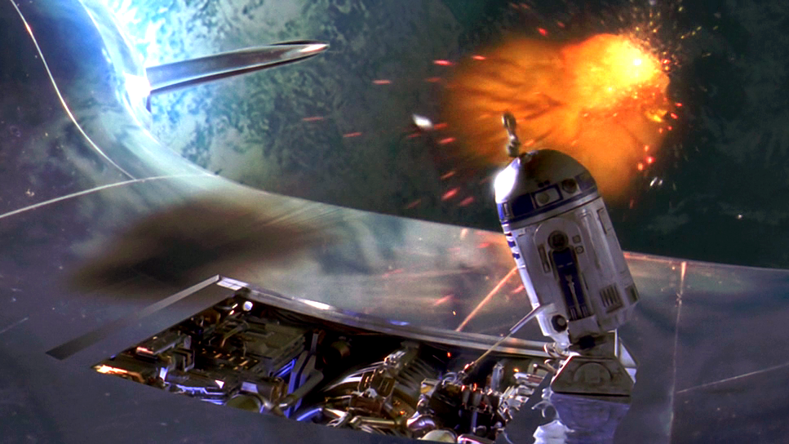
REFACTORING
WHAT IS REFACTORING?
Refactoring is a disciplined technique for restructuring an existing body of code, altering its internal structure without changing its external behavior.

Slide 44
REFACTORING
WHEN TO EXTRACT FUNCTION:
WHEN TO EXTRACT CLASS:
Too many responsibilities
Low cohesion
More than one reason to change
Duplication
Indentation
Unclear intent
More than one task
OTHER REASONS:
POOR NAMES
FEATURE ENVY
SHOTGUN CHANGE

Slide 45
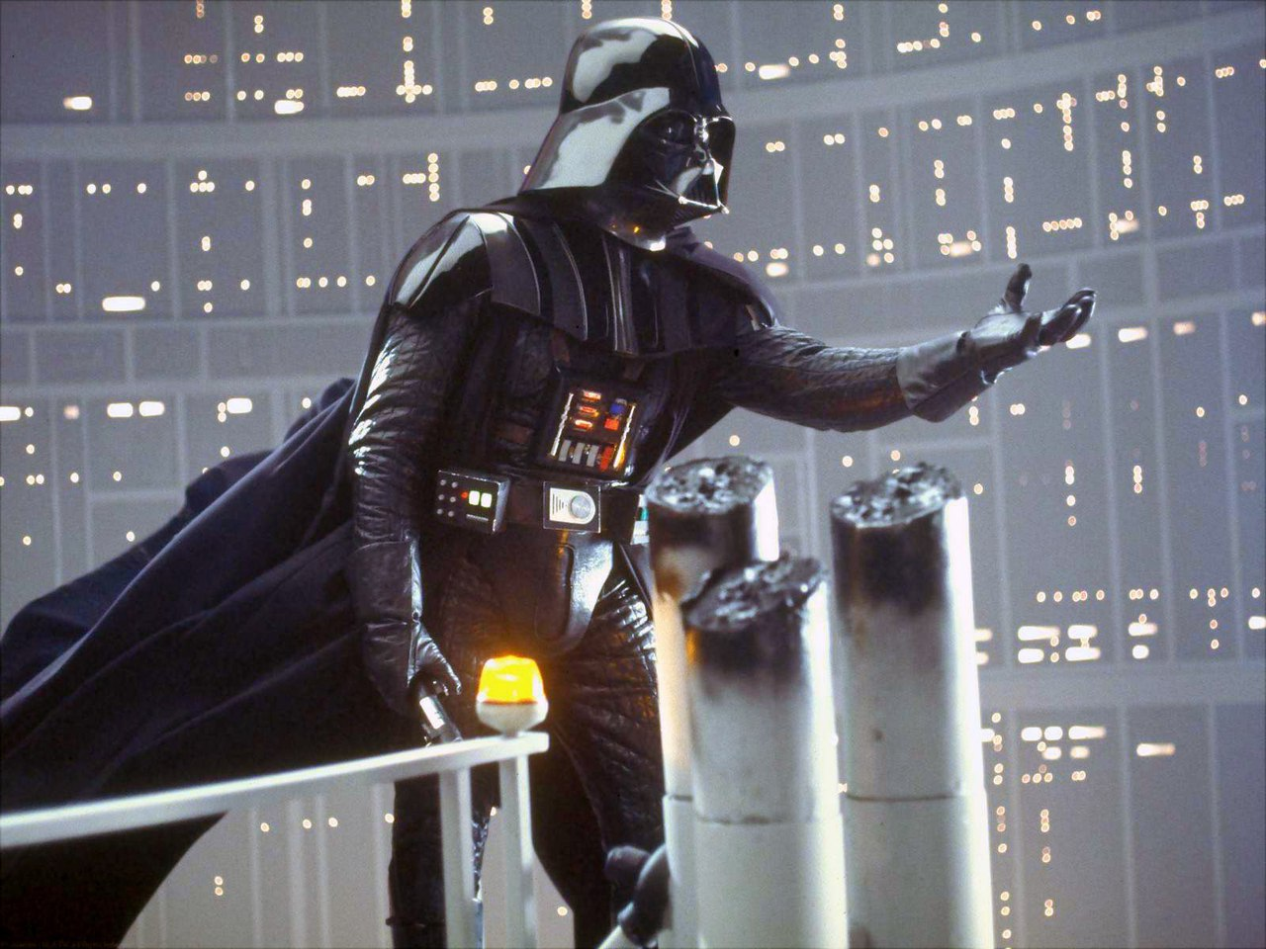
REFACTORING
DON’T COME TO THE DARK SIDE WHILE MAKING A REFACTORING

Slide 46
REFACTORING
MAGIC STRINGS
DIRTY
CLEAN
if (employeeType == “manager”)
{
DoSomething();
}
if (acessLevel == “read”)
{
DoSomething();
}
if (employeeType == EmployeeType.Manager;
{
DoSomething();
}
enum EmployeeType
{
Worker,
Manager,
Chief
}
//Or use constants
const string readAccess = “read";

Slide 47
REFACTORING
MAGIC NUMBERS
DIRTY
CLEAN
if (age > 21)
{
DoSomething();
}
if (status == 2)
{
DoSomething();
}
int legalAge = 21;
if (age > legalAge)
{
DoSomething();
}
if (status == Status.Active)
{
DoSomething();
}

Slide 48
REFACTORING
TERNARY ELEGANCE
DIRTY
CLEAN
if (isSpeaker)
{
registrationFee = 0;
}
else
{
registrationFee = 50;
}
int registrationFee = isSpeaker ? 0 : 50;

Slide 49
REFACTORING
ENCAPSULATE COMPLEX CONDITIONS
DIRTY
CLEAN
if (employee.Age > 55 &&
employee.YearsEmployed > 10 &&
employee.IsRetired)
{
// logic here
}
if (IsEligleForPension(employee))
{
// logic here
}
public bool IsEligleForPension(Employee employee)
{
return employee.Age > 55 &&
employee.YearsEmployed > 10 &&
employee.IsRetired;
}

Slide 50
REFACTORING
CODE SMELLS
Long methods
Large class
Long parameter list
Magic string and numbers
Many conditional statements (switch and if)
Excessive inherited functionally
Creating new code not knowing that its already exists
Making any modifications requires many changes to many different classes.
Unnecessary comments
Duplicate code
Dead code
One class uses the internal fields and methods of another class. Feature envy
Using series of calls ( a().b().c().d() )
Middle man or class that simply delegating responsivities.

Slide 51
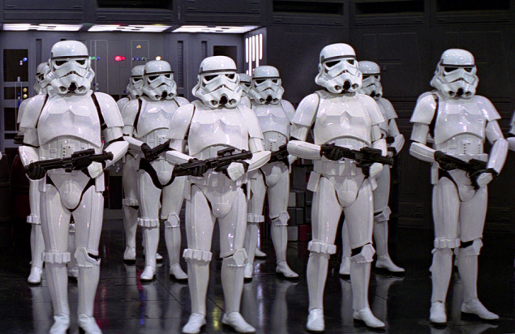
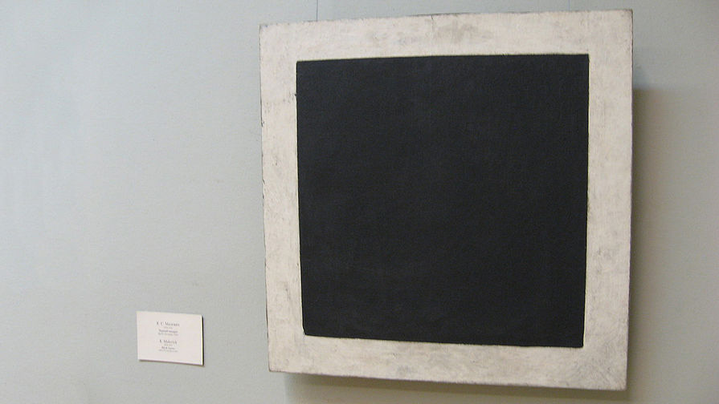

REFACTORING
Core programming principles
DRY Don’t repeat yourself.
KISS Keep it short and simple.
YAGNI You aren’t gonna need it.

Slide 52

QUESTIONS?

Slide 53

THANK YOU
Guleaev vladislav
Am Engineer
+373 79289335
vladislav.guleaev@endava.com

